Slide 1

Branch predictor.
WE DIRECT YOU TO THE branch OF YOUR
REQUIREMENTS!
WE MAKE IT EASY FOR U!!

Slide 2
OBJECTIVES :
Train Artificial Network models to perform classification tasks to acknowledge the precise branch recommendations with good specification of branch best suiting the clients' features of rank, college, caste, gender.
Branch predicting is an important decision in students life, our project aims at providing guidance to make proper assumptions and have accurate calculations.
This Branch predictor is based on category , rank , college , gender entered and on last years openings and on closing ranks.
Understand the theory and intuition behind machine learning models of multiple classification.
Effortless and smart decision making to the students by minimising their work load.
Fast, efficient and reliable tool for quick access of information.

Slide 3
BENEFICIARIES : Students
Applicants’ convenience: The applicants can get branch at their convenience without taking the workload of memorizing and analysing different criteria’s of rank, college ,gender and caste.
Greater reliability : the machine learning models account to greater reliability as it has all the necessary dataset and the accurate predictions are made using multiple classification algorithm such as decision tree and random forest of machine learning.
Easy access: This application can be accessed anytime and anywhere from the world without any difficulty and with great ease.
User friendly: This application will be user friendly since the user interface will be simple and easy to understand even by the common man.
Saves time: This application can help in saving time since there is no need to worry about selecting college for their required branch.

Slide 4
DATA INSIGHTS :
INPUT FEATURES :
1. College
2. Rank
3. Caste (among OC ,SC ,ST ,BC-A ,BC-B ,BC-C ,BC-D ,BC-E)
4. Gender (among male ,female )
OUTPUT FEATURES :
1. Branch name(CSE ,ECE ,EEE ,ME ,CE)

Slide 5
MACHINE LEARNING MODEL
CLASSFICATION
Classification is the task that requires the use of machine learning algorithms that
learn how to assign a class label to examples from the problem domain.
MULTICLASS CLASSIFICATION
Multi-class classification is the task of classifying elements into
different classes .Unlike binary, it doesn’t restrict itself to any number of classes.
Using decision tree and random forest.

Slide 6
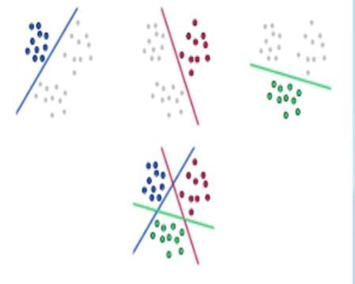
Multi class classification picture

Slide 7

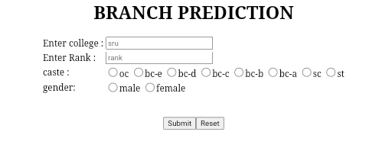
WIRE FRAME MODEL OF WEB APPLICATION

Slide 8

Thank you!!

